Slide 1
Presence of Opiates in Wastewater
Drew Gobbi, Olivia Wang, Olatunji Akinbule, Maddie Warndorf
External Validity

Slide 2
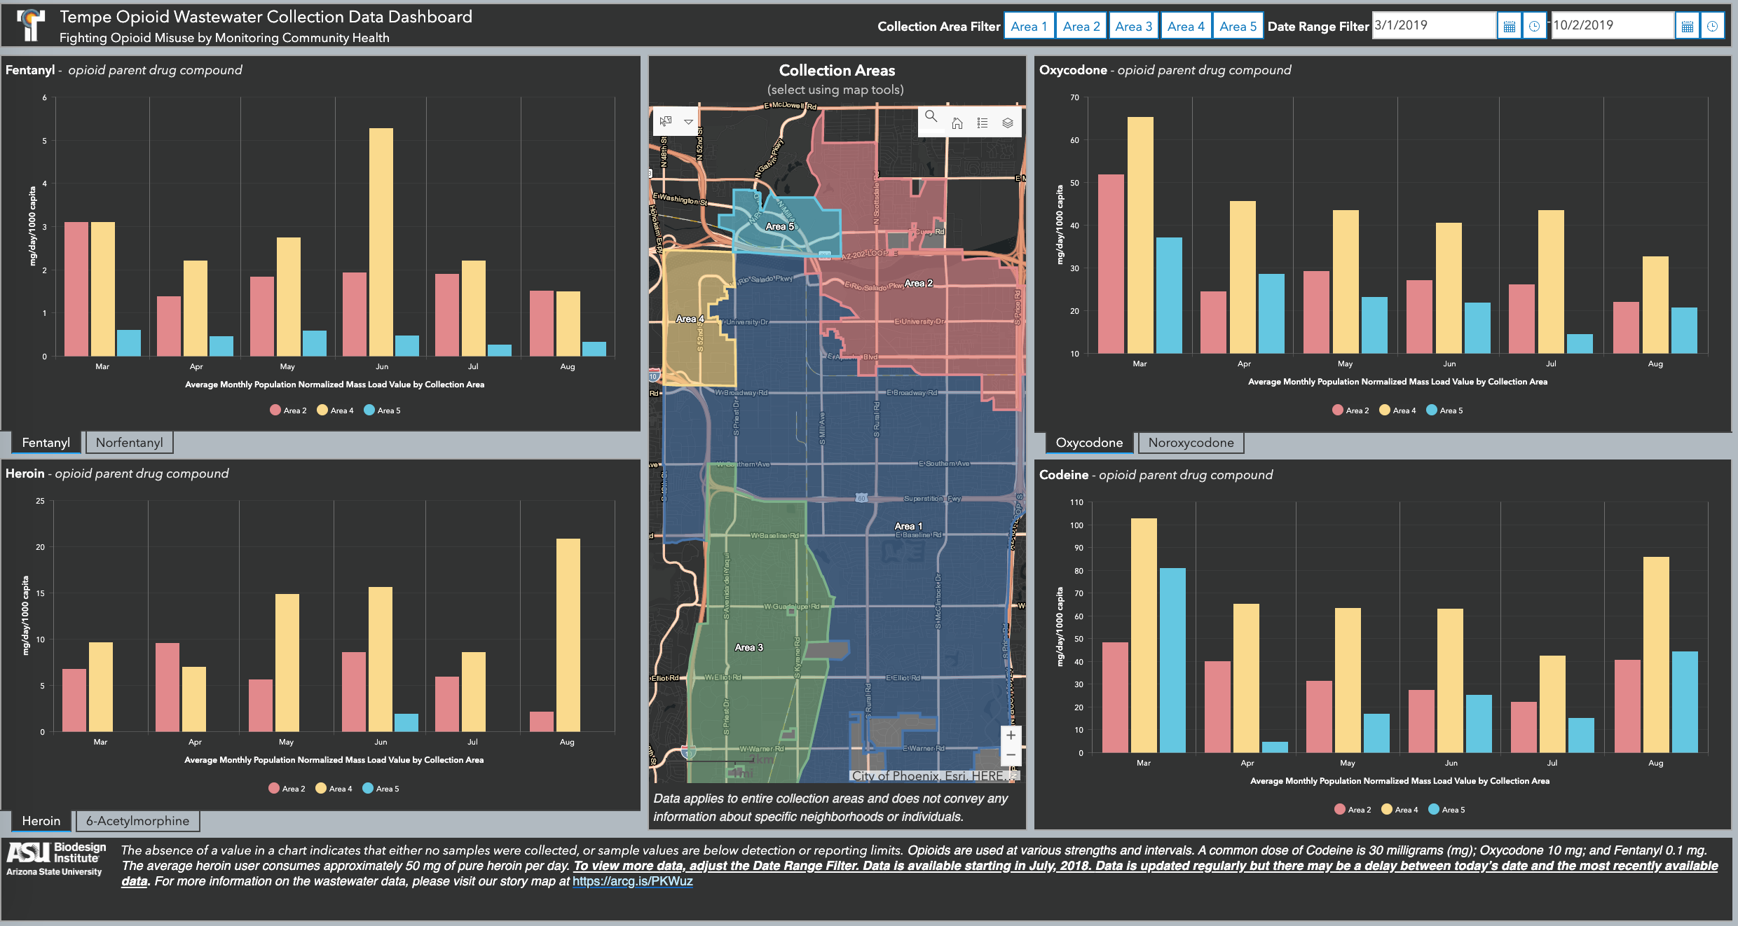
Source of Pilot Data
The source of pilot data is from the feature layer information published by TempeData on Esri ArcGIS which supports the Opioid Wastewater Collection Data Dashboard.
https://www.arcgis.com/home/item.html?id=93ee24cbf945405c8469742555670fc5&view=list#overview
Photo taken from Tempe Opioid Wastewater Collection Data Dashboard. https://tempegov.maps.arcgis.com/apps/opsdashboard/index.html#/69d996bc23dc461f82d01f47a5d70bfe

Slide 3
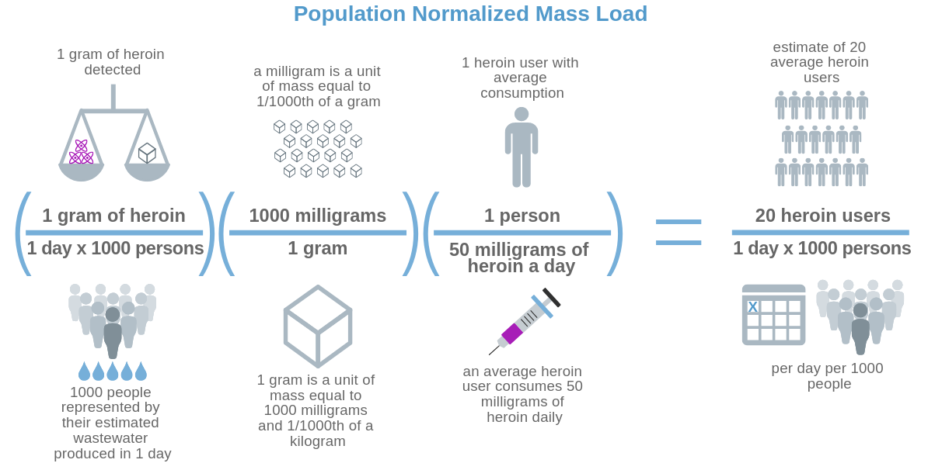
Descriptive Statistics of Pilot Data
There were three collection sites.
Once the preprocessing was completed, there were four features for each collection site.
Site - Area the sample was pulled from.
Either TP02, TP04, or TP05
Sample_Date - date that the sample was taken on.
Range is from 5/14/18-8/25/19
All drugs were tested each day.
Chemical - the chemical that was tested
Either 6-Acetylmorphine, Codeine, Fentanyl, Heroin, Norfentanyl, Noroxycodone, or Oxycodone
Population Normalized Mass Load (mg/day/1000 capita) - is the calculated measurement of drugs that are detected per day for a set number of people within the city (“Fighting Opioid Misuse by Monitoring Community Health”, 2019)
Photo taken from the City of Tempe and Arizona State University Partner to Study City Wastewater for Public Health Information’s Fighting Opioid Misuse by Monitoring Community Health website. https://www.arcgis.com/apps/Cascade/index.html?appid=92073d7f6a6a498b987f2afdab1b9471

Slide 4
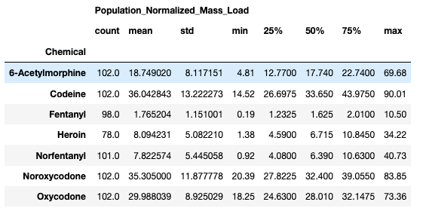
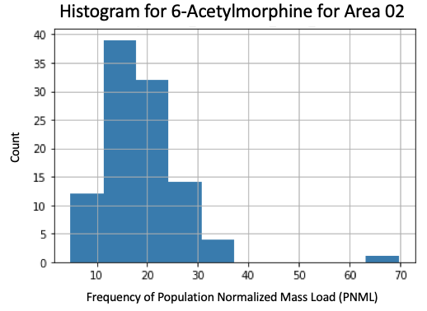
Descriptive Statistics for Collection Site TP02

Slide 5
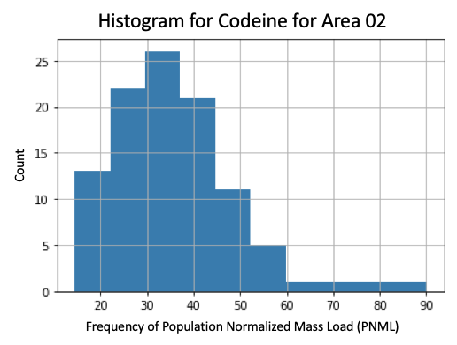
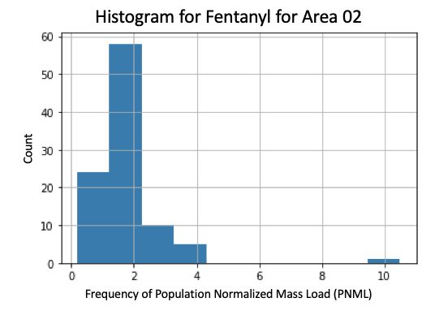
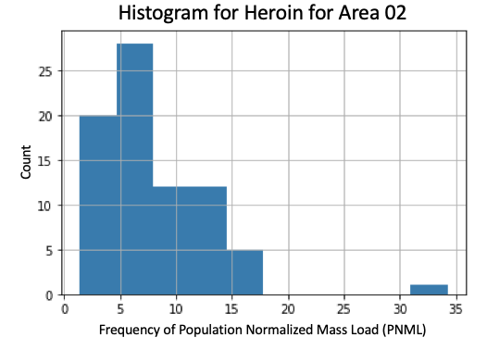
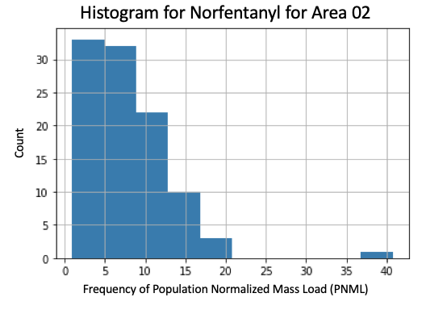
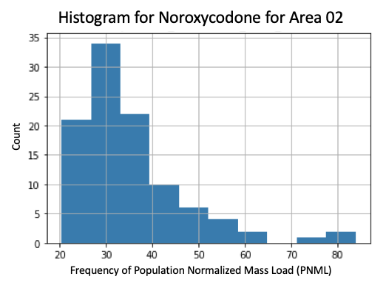
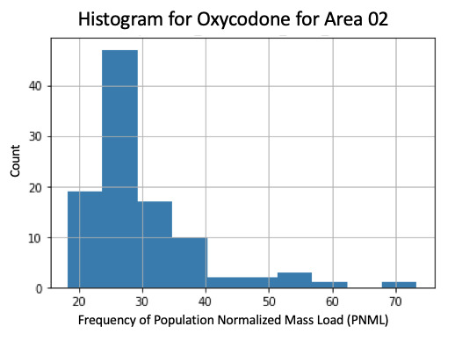
Descriptive Statistics for Collection Site TP02

Slide 6
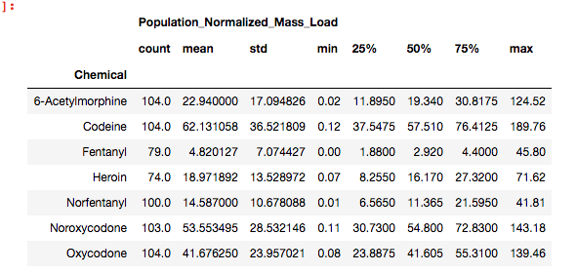
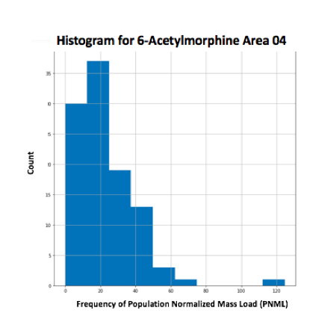
Descriptive Statistics for Collection Site TP04

Slide 7
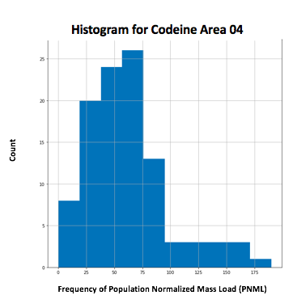
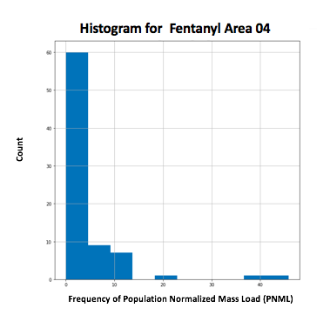
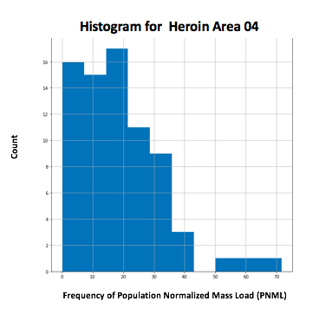
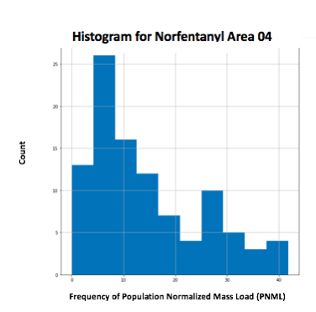
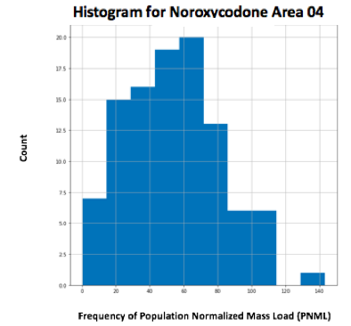
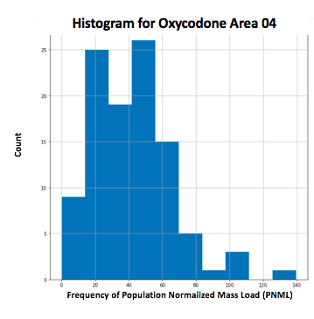
Descriptive Statistics for Collection Site TP04

Slide 8
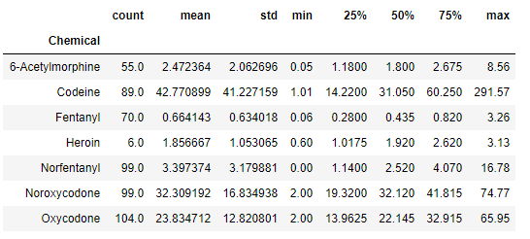
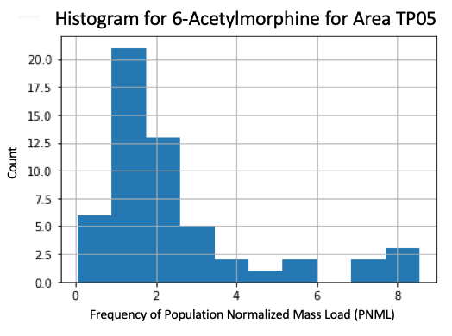
Descriptive Statistics for Collection Site TP05

Slide 9
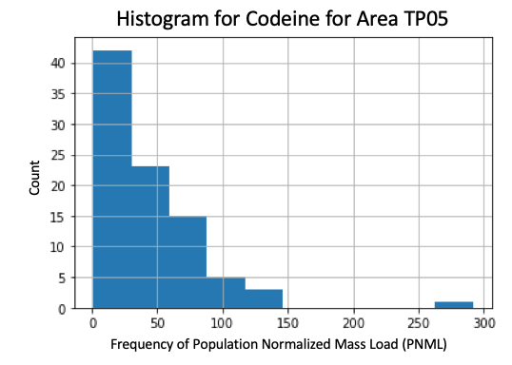
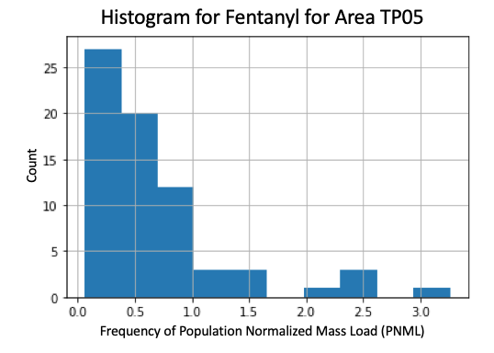
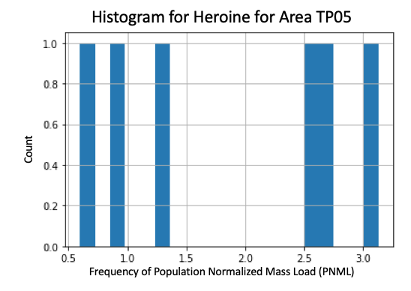
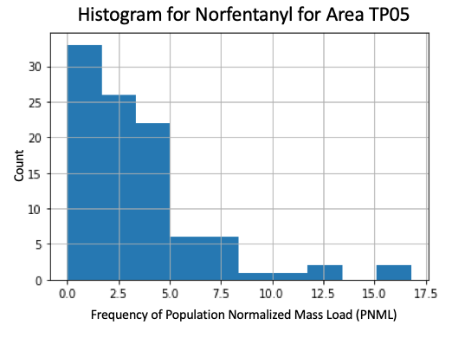
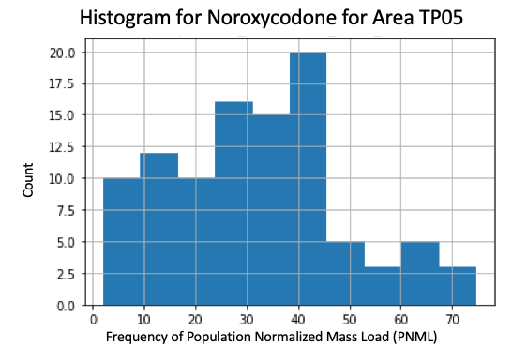
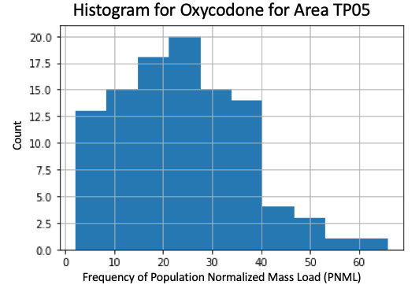
Descriptive Statistics for Collection Site TP05

Slide 10
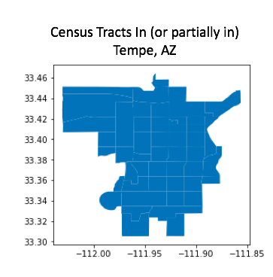
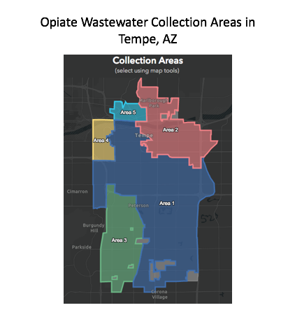
Unit of Analysis
Census tracts within the five collection sites (sampled by ASU Biodesign Institute) for PNML estimates
Census tracts provide an accessible unit for merging useful covariates (economic, demographic, etc.)
PNML estimate represents average drug use per 1000 in collection site
Assuming averages hold constant across tracts (no-ecological fallacy)

Slide 11
Theoretical Population, Accessible Population, and Sampling Frame
Theoretical population: Drug users who live in Tempe Arizona. This is the population we are looking to generalize to. We want to know what contributes to overall drug use across all of Tempe
Accessible population: Drug users who live in the 3 collection sites (TP02, TP04 and TP05). The observations in the data represent the drug users we are able to detect and study
Sampling Frame: Population Normalized Mass Load (PNML) estimates of drug use per 1000 taken from the 3 collection sites (TP02, TP04 and TP05). These represent our best guess at the total number of drug users within the accessible population that we will attempt to generalize to the entire city

Slide 12
Size of Sample
Our sample has around 2400 observations in total, which includes 3 collection sites with each containing around 800 observations.
Observations are added to each collection site daily, so our dataset will grow over time.

Slide 13
Threats to External Validity of Sampling Strategy
Not likely to be externally valid due to differences in drug and health policy between localities that may influence the behavior of drug users and/or the availability of drugs
Ex1: Cities can prioritize treatment or enforcement
Ex2: States can regulate where drugs are sold
Ex3: Drug disposal can differ at local or state level

Slide 14
Specific Sampling Strategy
Non-probability convenience sample of all of the data available.
This is appropriate because of the limited sample size. Sampling tracts would be inappropriate because:
Not the unit at which PNML is measured
Would further restrict sample size
We believe it is appropriate to include information on each observation in the data at the tract level so that we can include features of the sample population that may help explain (or more likely just relate to) the estimates of drug use per 1000 in the data.

Slide 15
Questions?

